Slide 1


Personal Productivity for the Differently Wired
(And everyone is wired differently.)

Slide 2
First Steps
Starting With the End In Mind

Slide 3
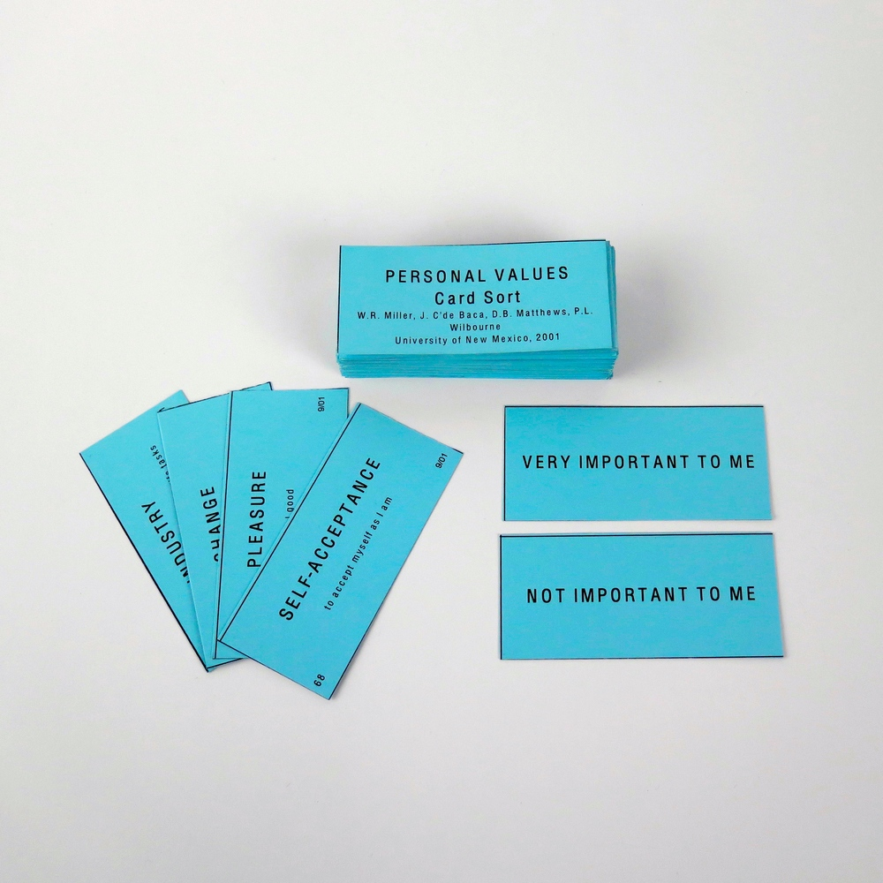
What Do You Value?
Knowing your values makes it easier to say No.
Values are high level guidestones.
Try to limit yourself to 3-5. Making difficult choices is part of the process.
W.R. Miller, J. C’de Baca, D.B. Matthews, P.L. Wilbourne University of New Mexico, 2001
https://www.motivationalinterviewing.org/sites/default/files/valuescardsort_0.pdf

Slide 4

Goals
Goals support your values
Goals are contextual
Limit yourself to one goal per context
Focus!
You can always make a “Someday/Maybe” list to save all the goals you’re not focused on

Slide 5
Planning and Execution
Patterns and Antipatterns

Slide 6
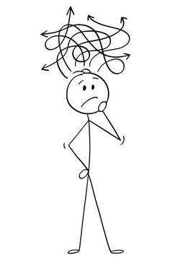
Antipattern: Trying To Remember Everything
Your brain sucks at remembering things… and it knows it
Working memory only goes so far
Overloading your memory can lead to chronic stress… which reduces your brain’s capacity further
https://divergentpatterns.com/antipattern/TryingToRememberEverything

Slide 7

Pattern: The Inbox
An easily accessible and visible place to collect important information
Regular review teaches your brain that it can trust the Inbox to remember things
Reach Inbox Zero Daily
https://divergentpatterns.com/pattern/TheInbox

Slide 8
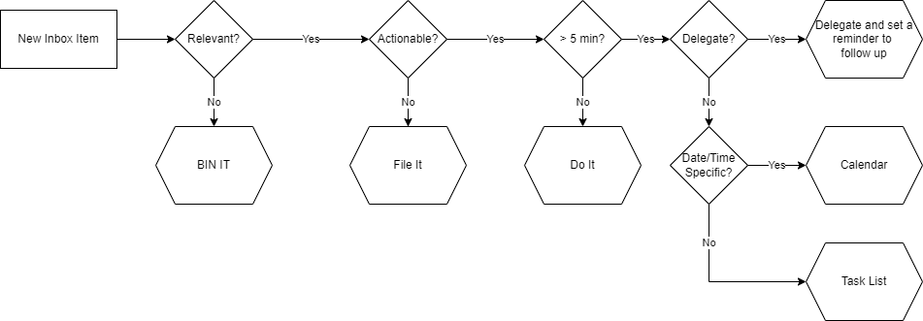
Information Triage

Slide 9
Tools
Inbox
Task List
File
Physical tray
Notebook
Whiteboard
Email to self
Paper
Trello
Dedicated task list app
Github Projects
Physical Files
Cloud Storage
Github repository

Slide 10
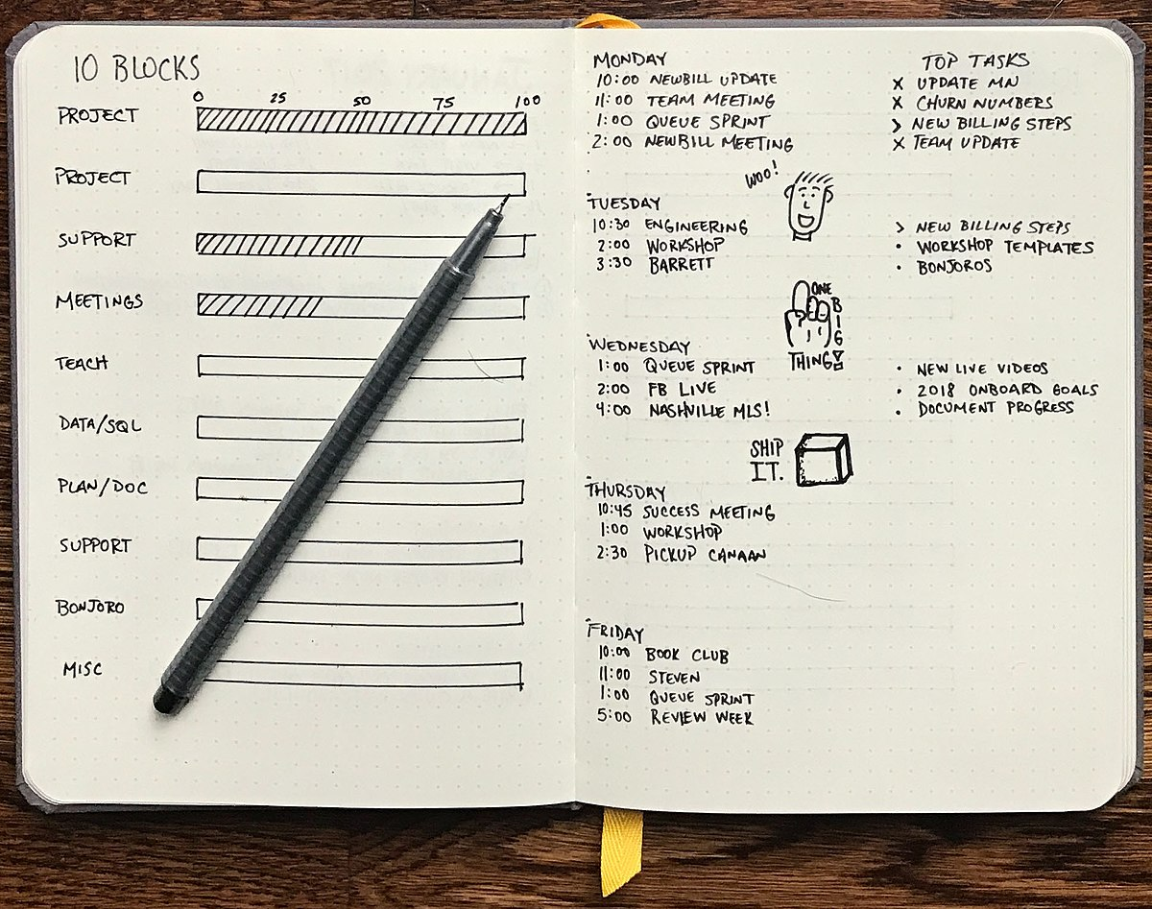
The Engineering Notebook
Physical Journals – Bullet Journal
Digital Journals – Markdown + Github
If it takes more than five minutes to find or figure out… Record Your Research!
https://divergentpatterns.com/pattern/RecordTheResearch

Slide 11
Review Regularly!
Daily
Weekly
Get to Inbox Zero
Review calendar
Review task lists
Make a plan for the day
Brainstorm new items for Inbox
Cull Calendar and Task List for items that are no longer relevant

Slide 12

Antipattern: Be The Batman
Symptom: You’re martyring yourself on the altar of misguided burden of sole responsibility.
“I’m whatever Gotham needs me to be.”
Nobody expects this of you.
Unless they don’t care about your wellbeing.
In which case, maybe #$&% those people.
https://divergentpatterns.com/antipattern/BeTheBatman

Slide 13
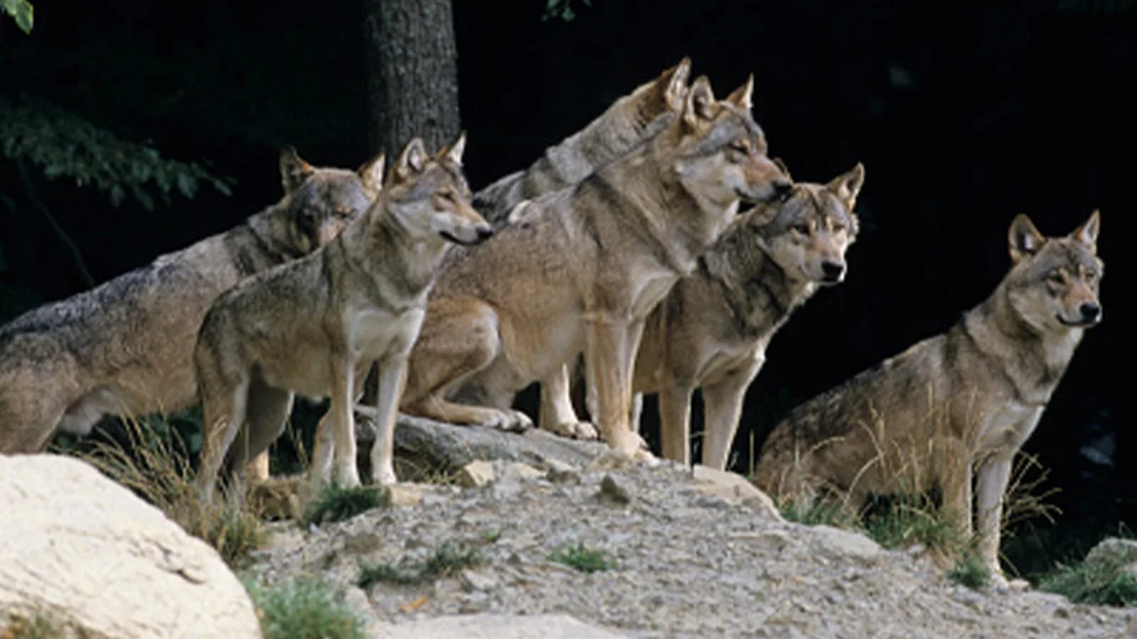
Pattern: Rely On Pack
Helping feels good to most people.
Giving someone an opportunity to help you is a chance for them to have that good feeling.
When someone asks for help, help without judgement.
When you need help, ask without fear.
https://divergentpatterns.com/pattern/RelyOnPack

Slide 14
Pattern: Reasonable Heroics
When failure isn’t an option and time/resources are thin, sometimes you do have to push.
Make sure that you have a solid Definition of Done before you start.
Find the Next Step.
Make lots of Breadcrumbs.
Rely on Pack
And most importantly of all…
https://divergentpatterns.com/pattern/ReasonableHeroics
https://divergentpatterns.com/pattern/DefinitionOfDone
https://divergentpatterns.com/pattern/NextStep
https://divergentpatterns.com/pattern/Breadcrumbs

Slide 15
Big Pushes Demand Big Breaks.

Slide 16

Pattern: Definition of Done
SMART Goals
Specific
Measurable
Achievable
Relevant
Timeboxed
Figure these out before you start!
https://divergentpatterns.com/pattern/DefinitionOfDone

Slide 17
Getting Unstuck
Patterns for Effectiveness

Slide 18

Pattern: Just Five Minutes
When you’re dreading a task because it feels too big, set a timer for five minutes.
If you feel like continuing after that, congratulations, you have momentum.
If you don’t, you still made some progress. Be sure to make…
https://divergentpatterns.com/pattern/JustFiveMinutes

Slide 19
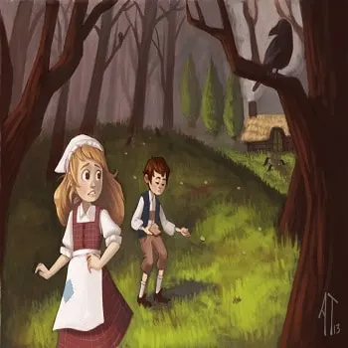
Pattern: Breadcrumbs
When you can’t complete a task or project in one go, make notes that will help you find your place later.
Project notebooks / wikis
ToDo comments in code
Flowcharts and sketches
https://divergentpatterns.com/pattern/Breadcrumbs

Slide 20

Pattern: Reacquaint
When you pick up a task or project that has been put aside:
Make time to reacquaint yourself with the situation – this is a legitimate task
Review whatever notes and breadcrumbs exist
Record your research!!
Develop your next step and add it to your notes
https://divergentpatterns.com/pattern/Reacquaint

Slide 21

Pattern: Martian Persistence
"At some point, everything’s gonna go south and you’re going to say, this is it. This is how I end. Now, you can either accept that, or you can get to work. That’s all it is. You just begin. You do the math. You solve one problem, and you solve the next one, and then the next. And if you solve enough problems, you get to come home."
-The Martian
https://divergentpatterns.com/pattern/MartianPersistence

Slide 22
Accountability
How to Build Habits

Slide 23
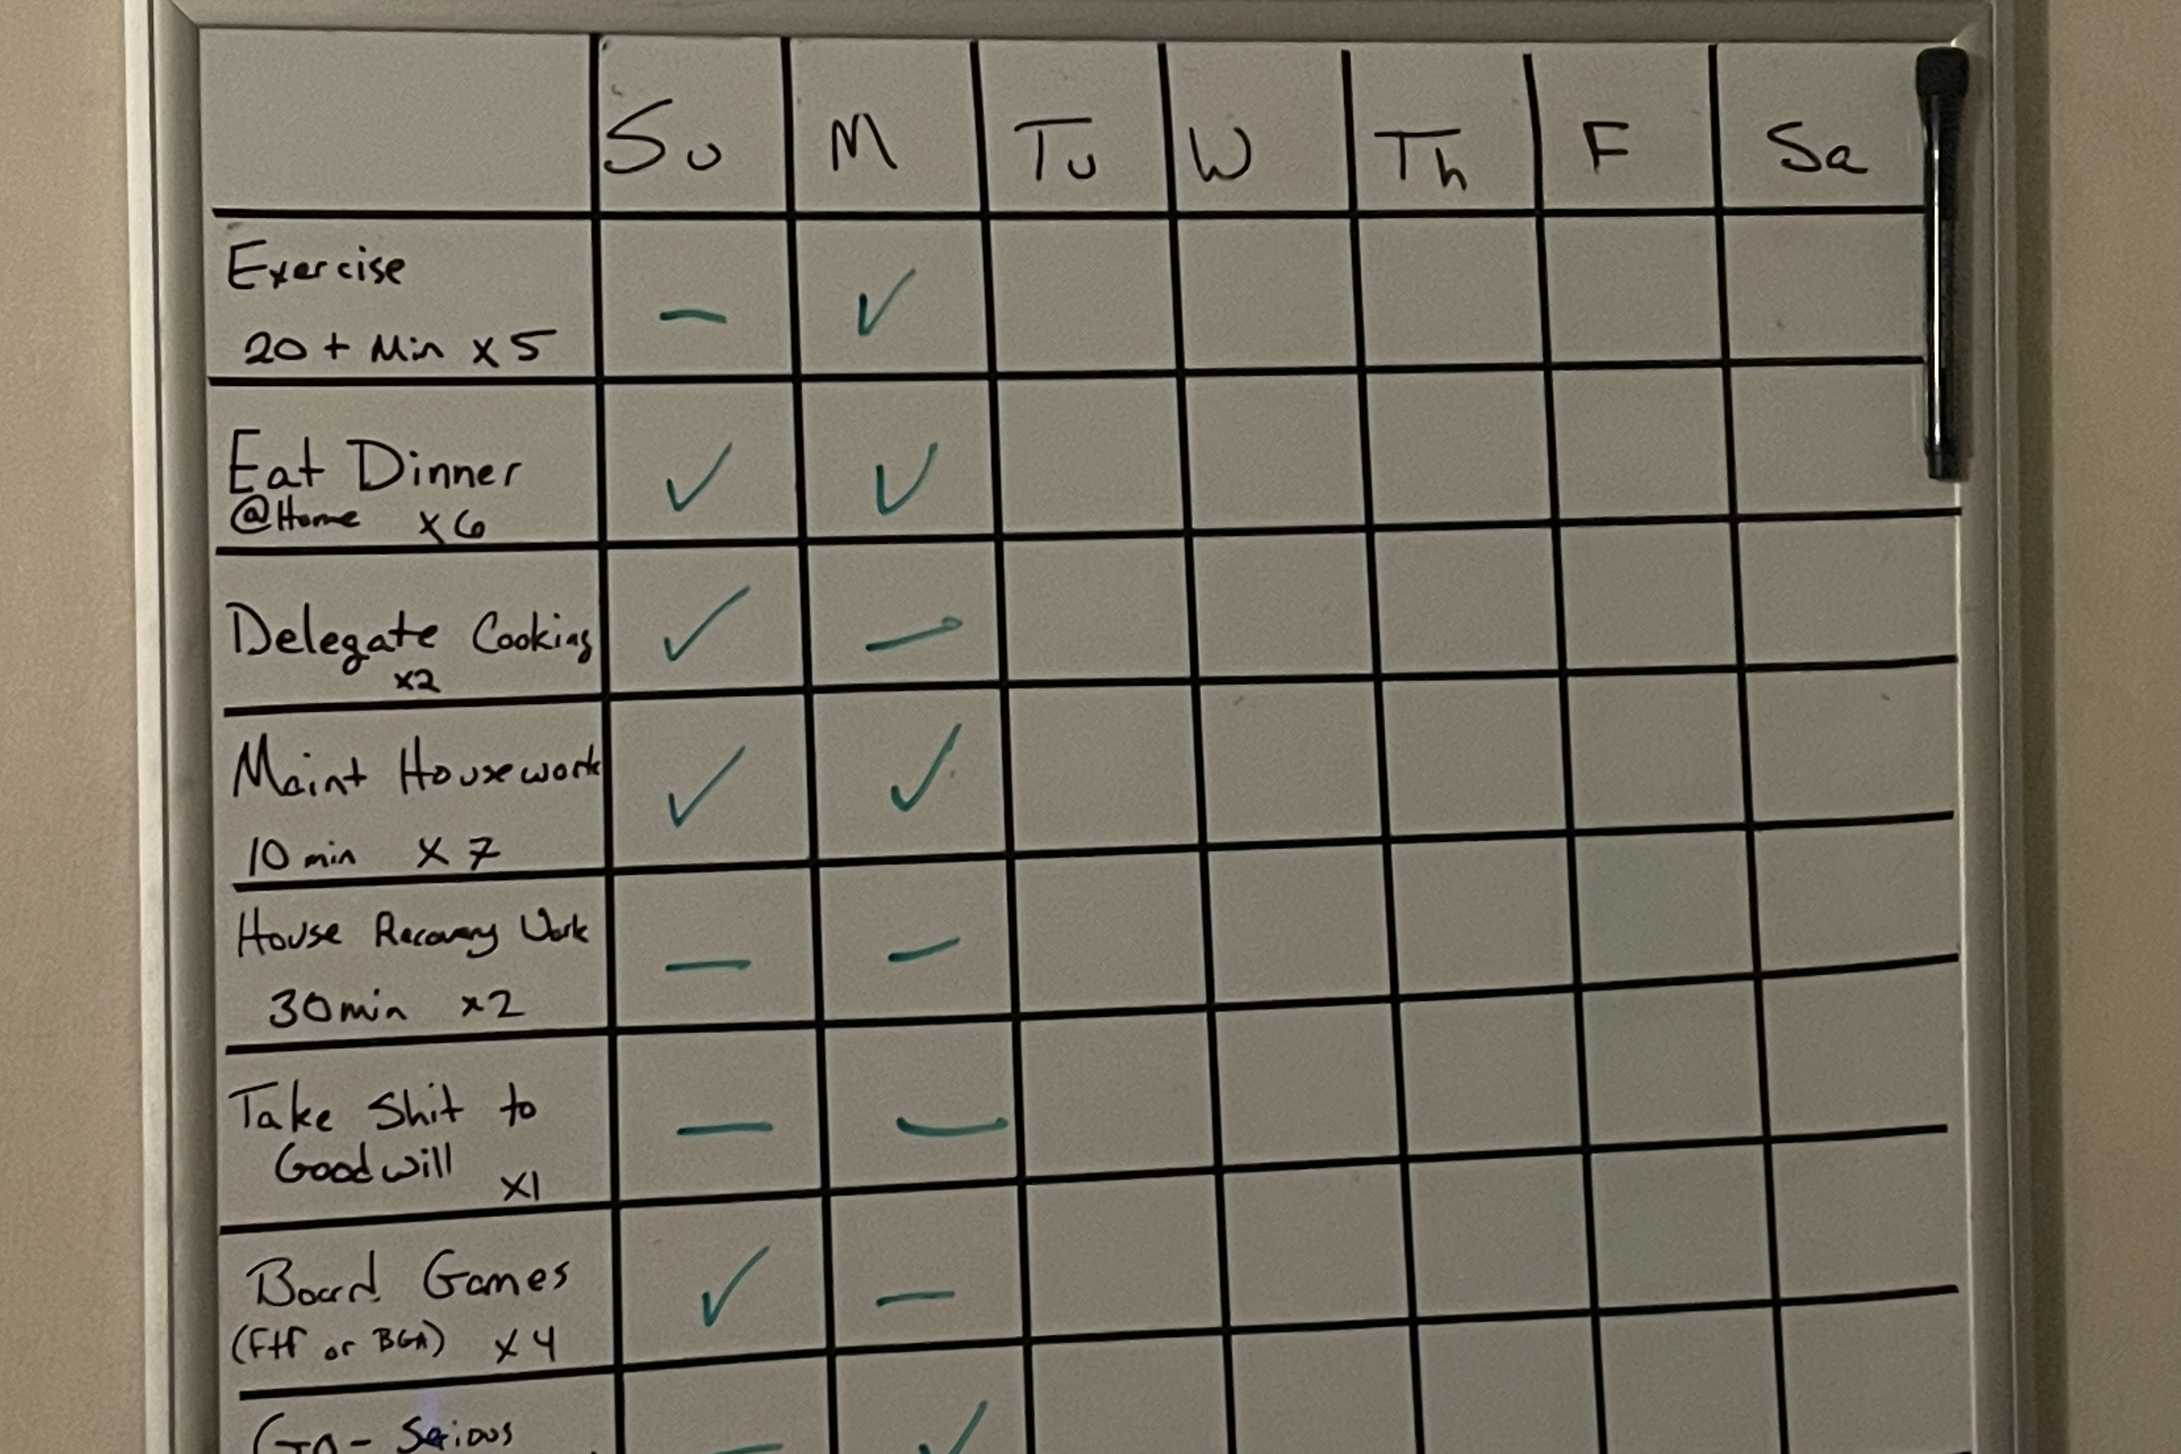
The Commitment Board

Slide 24
Commitments and Accountability
Commitment Board Specs
Accountability
Visible
Accessible
Updated daily
Contains only the habits you most care about building – Only one or two to start.
Find at least one person – someone who is not a romantic partner – to be on your accountability team.
Make sure communication with your accountability team is easy. Discord or Slack are great tools for this.
Make a daily “standup” style ritual for your accountability team at the start of the day, and an end of day check in to report on your successes and challenges.
The more the merrier.

Slide 25
Final Thought
This presentation has been about tools and processes that have worked for me personally.
Your mileage will absolutely vary.
When you find that you aren’t living up to your own expectations, or that you’re resisting using the tools and processes you’ve selected for yourself, it is critical that you not fall into the trap of calling yourself “lazy”, “incompetent”, or any other pejorative.
Instead, listen to yourself, find the root cause of the resistance, and try something new.
There is no such things as “lazy.” There are only unexamined priorities and limitations.

Slide 26
Resources
https://www.divergentpatterns.com
https://todoist.com/
https://gettingthingsdone.com/
https://imperfectinspiration.com/planner

Slide 27
Q & A

